Slide 1
Event locator for the data scientist meet - 2021 in Los Angeles
Applied Data science Capstone Project
-Sathya Narayanan Muralidaran

Slide 2
Project Description
A company in California was planning to set up a Data Science Annual meet-2020 in Los Angeles
Due to Covid 19,data science meet was proposed to happen online.
New proposal was made for the year 2021 with an idea of 5-day event.
It needs to be planned accordingly where the people can spend quality time during off hours .
Challenge is to choose the right spot where people can engage their leisure times in Restaurants, Parks and shopping malls.
The venue should give some idea of choosing the right places in Los Angeles

Slide 3
Data Selection
Use Four Square API,
we need to identify the below places in LA
Hotel
Restaurant
Parks
Shopping malls
We need to convert Json file to data frame for the above searches
Apply Data cleansing activity to all the frames

Slide 4
Project Activities
Libraries Import
Using Foursquare credentials publishing connections with Foursquare API by passing the necessary parameters
Collecting data for Hotels
Creating Data frames for Hotels, Restaurants, Parks and Shopping Malls
Removing unwanted Columns for Hotels, Restaurants, Parks and Shopping Malls
Deleting Blank or NAN rows and also ensure no duplicates
Repeat the above 4 steps for Restaurants, Parks and Shopping Malls
Consolidate the all the data and visualize the same in folium map.

Slide 5
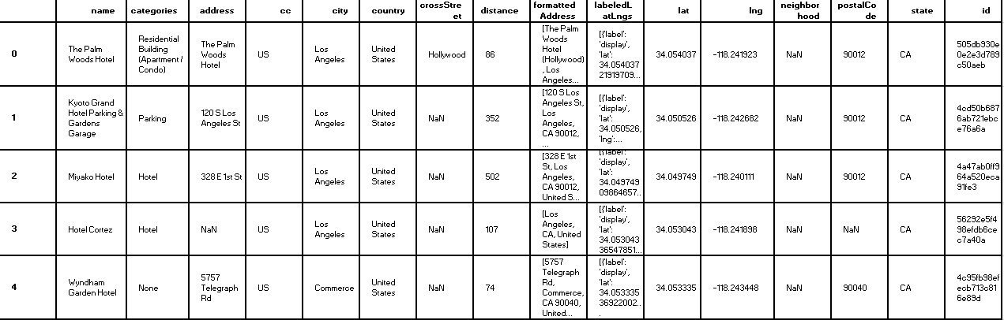
Sample data before cleaning
Hotel data frame

Slide 6
Data Cleansing Activities
Removing unwanted columns
Removing Duplicates
Removing data with NAN values
Removing invalid data
Removing data that belongs to other category
we need to do data cleansing activity for data frame such as Hotels, Restaurants ,Parks and Shopping malls and consolidate the data to neighbourhood frame. This is the base data frame for clustering.

Slide 7
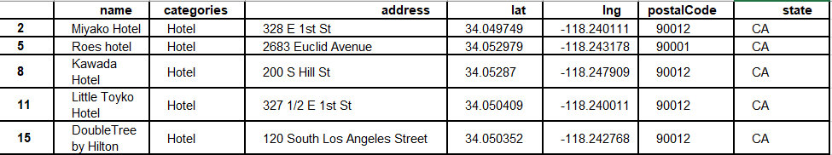
Sample data After cleaning
Hotel data frame

Slide 8
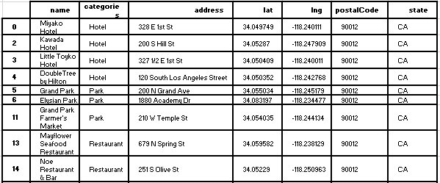
Data clustering
During data clustering all our data will be combined into a single neighbourhood data frame.
This data is the base data for generating maps using Folium

Slide 9
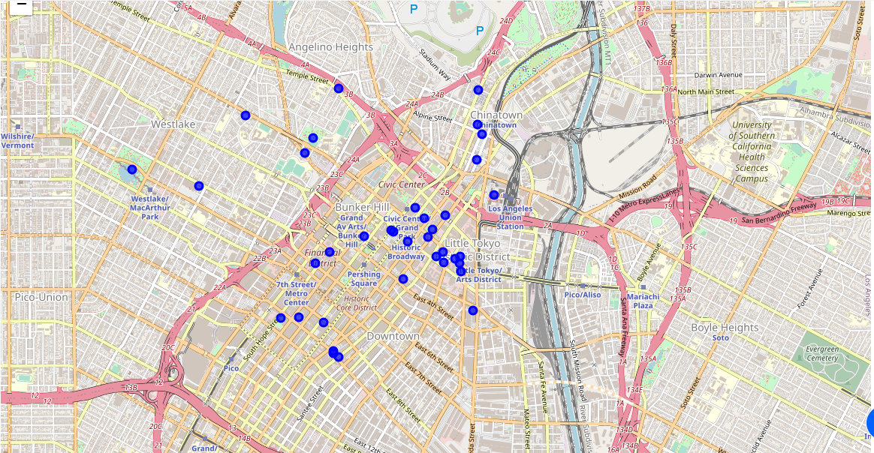
Data visualization - folium MAP

Slide 10
Conclusion
Accordingly, we finalize that best place is southern California area of Los Angeles with the postal code 90012.This is the best place to conduct an event where all the Restaurants, Parks and Shopping malls are near to hotels.

Slide 11
Thank YOU

